Slide 1

CLASS 5 CD-404 STAGES IN DATA SCIENCE PROJECT UNIT I
STAGES IN DATA SCIENCE PROJECT
Prof. Vineeta Shrivastava
Assistant Professor
Department of Computer Science & Engineering
LNCT-E, Bhopal
Lakshmi Narain College of Technology Excellence, Bhopal

Slide 2
CLASS 5 CD-404 STAGES IN DATA SCIENCE PROJECT UNIT I
AGENDA
Stages in data science project
Business Understanding
Data Mining
Data Cleaning
Data Exploration
Feature Engineering
Predictive Modeling
Data Visualization
Business Understanding
Prof. Vineeta Shrivastava
Assistant Professor
Department of Computer Science & Engineering
LNCT-E, Bhopal
Lakshmi Narain College of Technology Excellence, Bhopal

Slide 3
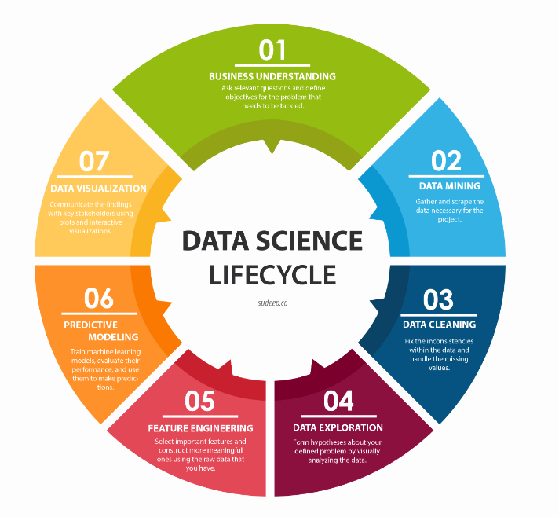
CLASS 5 CD-404 STAGES IN DATA SCIENCE PROJECT UNIT I
STAGES IN DATA SCIENCE PROJECT
Prof. Vineeta Shrivastava
Assistant Professor
Department of Computer Science & Engineering
LNCT-E, Bhopal
https://www.sudeep.co/data-science/2018/02/09/Understanding-the-Data-Science-Lifecycle.html
Lakshmi Narain College of Technology Excellence, Bhopal

Slide 4

CLASS 5 CD-404 STAGES IN DATA SCIENCE PROJECT UNIT I
Business Understanding
Business Understanding: This phase involves understanding the project's objectives, defining the business problem, and determining the success criteria.
Data Understanding: In this phase, the relevant data sources are identified, data quality is assessed, and initial insights are gained.
Prof. Vineeta Shrivastava
Assistant Professor
Department of Computer Science & Engineering
LNCT-E, Bhopal
Lakshmi Narain College of Technology Excellence, Bhopal

Slide 5
CLASS 5 CD-404 STAGES IN DATA SCIENCE PROJECT UNIT I
Business Understanding
The data scientists in the room are the people who keep asking the why’s.
They’re the people who want to ensure that every decision made in the company is supported by concrete data, and that it is guaranteed (with a high probability) to achieve results.
Before you can even start on a data science project, it is critical that you understand the problem you are trying to solve.
Prof. Vineeta Shrivastava
Assistant Professor
Department of Computer Science & Engineering
LNCT-E, Bhopal
Lakshmi Narain College of Technology Excellence, Bhopal

Slide 6
CLASS 5 CD-404 STAGES IN DATA SCIENCE PROJECT UNIT I
Business Understanding
According to Microsoft Azure’s blog, we typically use data science to answer five types of questions:
How much or how many? (regression)
Which category? (classification)
Which group? (clustering)
Is this weird? (anomaly detection)
Which option should be taken? (recommendation)
In this stage, you should also be identifying the central objectives of your project by identifying the variables that need to be predicted.
Prof. Vineeta Shrivastava
Assistant Professor
Department of Computer Science & Engineering
LNCT-E, Bhopal
Lakshmi Narain College of Technology Excellence, Bhopal

Slide 7
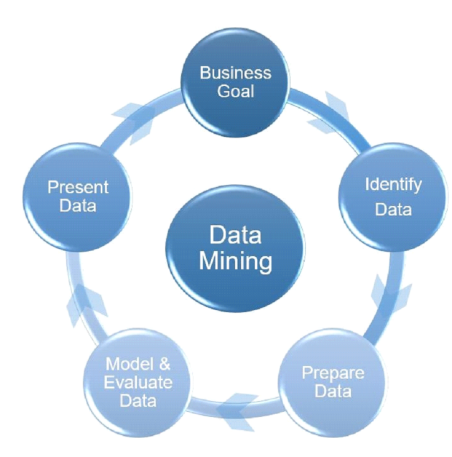
CLASS 5 CD-404 STAGES IN DATA SCIENCE PROJECT UNIT I
Data Mining
Data mining is the process of gathering your data from different sources.
At this stage, some of the questions worth considering are –
What data do I need for my project?
Where does it live?
How can I obtain it?
What is the most efficient way to store and access all of it?
Prof. Vineeta Shrivastava
Assistant Professor
Department of Computer Science & Engineering
LNCT-E, Bhopal
Lakshmi Narain College of Technology Excellence, Bhopal

Slide 8
CLASS 5 CD-404 STAGES IN DATA SCIENCE PROJECT UNIT I
Data Cleaning
We move on to the most time-consuming step of all - cleaning and preparing the data. This is especially true in big data projects, which often involve terabytes of data to work with.
The reason why this is such a time consuming process is simply because there are so many possible scenarios that could necessitate cleaning.
Prof. Vineeta Shrivastava
Assistant Professor
Department of Computer Science & Engineering
LNCT-E, Bhopal
Lakshmi Narain College of Technology Excellence, Bhopal

Slide 9
CLASS 5 CD-404 STAGES IN DATA SCIENCE PROJECT UNIT I
Data Cleaning
For instance, the data could also have inconsistencies within the same column, meaning that some rows could be labelled 0 or 1, and others could be labelled no or yes. The data types could also be inconsistent - some of the 0s might integers, whereas some of them could be strings.
One of the steps that is often forgotten in this stage, causing a lot of problems later on, is the presence of missing data.
Missing data can throw a lot of errors in the model creation and training.
Prof. Vineeta Shrivastava
Assistant Professor
Department of Computer Science & Engineering
LNCT-E, Bhopal
Lakshmi Narain College of Technology Excellence, Bhopal

Slide 10
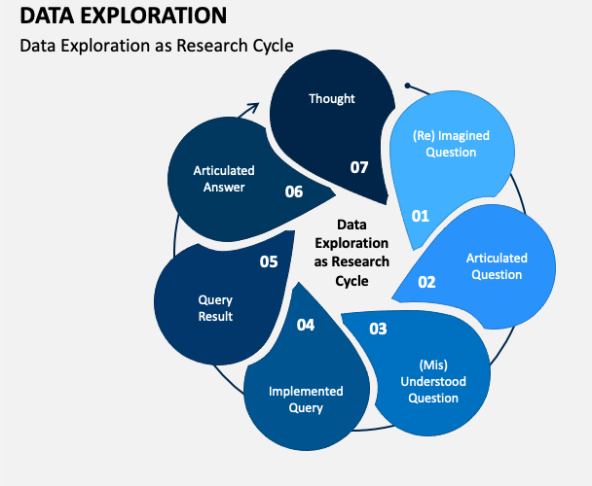
CLASS 5 CD-404 STAGES IN DATA SCIENCE PROJECT UNIT I
Data Exploration
The data exploration stage is like the brainstorming of data analysis. This is where you understand the patterns and bias in your data.
Prof. Vineeta Shrivastava
Assistant Professor
Department of Computer Science & Engineering
LNCT-E, Bhopal
Lakshmi Narain College of Technology Excellence, Bhopal

Slide 11
CLASS 5 CD-404 STAGES IN DATA SCIENCE PROJECT UNIT I
Data Exploration
It could involve pulling up and analyzing a random subset of the data using Pandas, plotting a histogram or distribution curve to see the general trend, or even creating an interactive visualization that lets you dive down into each data point and explore the story behind the outliers.
Prof. Vineeta Shrivastava
Assistant Professor
Department of Computer Science & Engineering
LNCT-E, Bhopal
Lakshmi Narain College of Technology Excellence, Bhopal

Slide 12
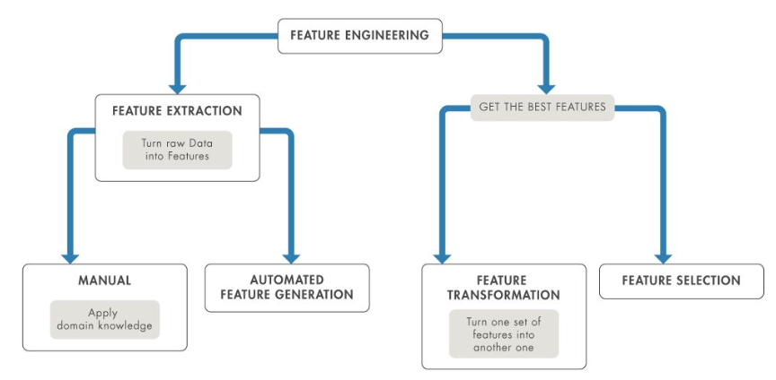
CLASS 5 CD-404 STAGES IN DATA SCIENCE PROJECT UNIT I
Feature Engineering
In machine learning, a feature is a measurable property or attribute of a phenomenon being observed. If we were predicting the scores of a student, a possible feature is the amount of marks they get.
Prof. Vineeta Shrivastava
Assistant Professor
Department of Computer Science & Engineering
LNCT-E, Bhopal
Lakshmi Narain College of Technology Excellence, Bhopal

Slide 13
CLASS 5 CD-404 STAGES IN DATA SCIENCE PROJECT UNIT I
Feature Engineering
Feature engineering is the process of using domain knowledge to transform your raw data into informative features that represent the business problem you are trying to solve.
This stage will directly influence the accuracy of the predictive model you construct in the next stage.
Feature selection is the process of cutting down the features that add more noise than information.
Prof. Vineeta Shrivastava
Assistant Professor
Department of Computer Science & Engineering
LNCT-E, Bhopal
Lakshmi Narain College of Technology Excellence, Bhopal

Slide 14
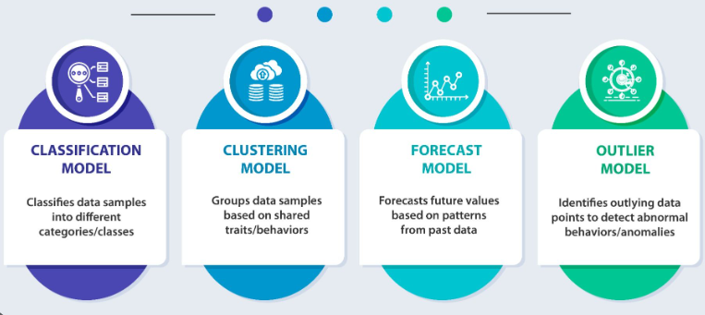
CLASS 5 CD-404 STAGES IN DATA SCIENCE PROJECT UNIT I
Predictive Modeling
Predictive modeling is where the machine learning finally comes into your data science project.
Prof. Vineeta Shrivastava
Assistant Professor
Department of Computer Science & Engineering
LNCT-E, Bhopal
Lakshmi Narain College of Technology Excellence, Bhopal

Slide 15
CLASS 5 CD-404 STAGES IN DATA SCIENCE PROJECT UNIT I
Predictive Modeling
Predictive modeling is a commonly used statistical technique to predict future behaviour.
Predictive modeling solutions are a form of data-mining technology that works by analyzing historical and current data and generating a model to help predict future outcomes.
Prof. Vineeta Shrivastava
Assistant Professor
Department of Computer Science & Engineering
LNCT-E, Bhopal
Lakshmi Narain College of Technology Excellence, Bhopal

Slide 16

CLASS 5 CD-404 STAGES IN DATA SCIENCE PROJECT UNIT I
Data Visualization
Data visualization is the graphical representation of information and data.
By using visual elements like charts, graphs, and maps, data visualization tools provide an accessible way to see and understand trends, outliers, and patterns in data.
Prof. Vineeta Shrivastava
Assistant Professor
Department of Computer Science & Engineering
LNCT-E, Bhopal
Lakshmi Narain College of Technology Excellence, Bhopal

Slide 17
CLASS 5 CD-404 STAGES IN DATA SCIENCE PROJECT UNIT I
THANKYOU
Prof. Vineeta Shrivastava
Assistant Professor
Department of Computer Science & Engineering
LNCT-E, Bhopal
Lakshmi Narain College of Technology Excellence, Bhopal

